Slide 1
Easify
Team - 3
Neeraj Kulkarni
Janvi Ramani
Anvai Patil
Dhruvil Shah
Varun Patel
Guided By
Professor Henry Wong

Slide 2





Agenda
Introduction
Team members
Problem Statement
Project Description
Personas
Technologies and Design
Front-end
Back-end
Cloud
Design Architecture
Sprint 5 recap & Sprint 6
Sprint Backlog
Test Cases
Burndown Chart
Velocity Chart
Completed Committed Ratio
Sprint 6 Results
Retrospective
Future work
Sprint 7 Use Stories

Slide 3
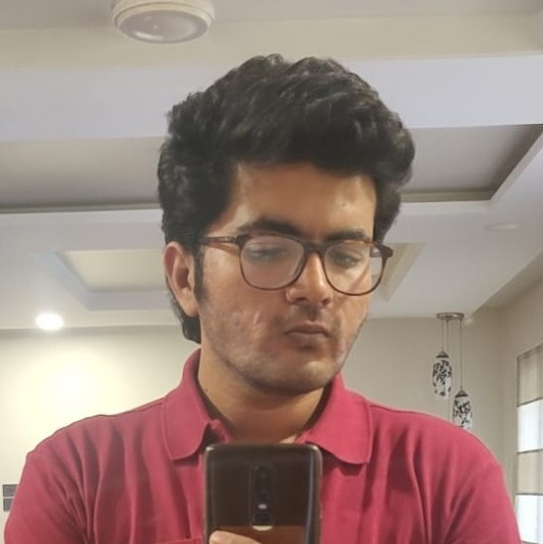



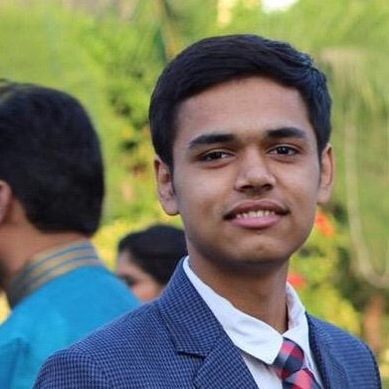
Neeraj Kulkarni Backend Developer
Janvi Ramani
Backend Developer
Anvai Patil
Frontend Developer
Dhruvil Shah
Cloud Engineer
Varun Patel
Full Stack Developer

Slide 4
Problem Statement
Using current scrum application , we can see that there can be end date failure in which people fail to finish the project. There can be situation such that people can be cooperative or committed.
Sometimes daily meetings can frustrate team members and they do not like to perform daily meetings.
Using the remote or onsite project, there can be situation such that one person transfer to another company in middle of project. In this situation, it is difficult to complete project and group will have negative impact.

Slide 5
Project Description
Easify Overview
We are designing an application called Easify. Easify is an application that helps you manage scrum-based projects easily and effectively.
To manage the project, Easify will provide Product Backlog management and Sprint Backlog management features. In addition, users can use Easify’s Share Images and Chat features to share each other work and thoughts.
The Calendar feature is there so that users can plan their work. Users can use the Activity Map feature to understand the project workflow and estimate the users’ workflow.

Slide 6
Personas

Slide 7

Persona - 1:
Name: John
Age: 45
Post: Product Owner
Currently, John is working from home as the owner of the product developed by the team. He is 45 years old and he has a family. It is his duty to ask the scrum master about the progress of the product. It is his responsibility to maintain the system and to determine if the product design will be completed on time. Easify gives him the ability to see the progress and track the work of his team. He can offer suggestions right away through this tool.

Slide 8

Persona-2:
Name: David
Age: 35
Post: Scrum Master
David manages a team of five people. The team isn't located in one city, so offline meetings are impossible. With Easify, he can view the progress of tasks and see the daily or weekly report. Additionally, he can prioritize the task so it can be worked on by the development team.

Slide 9

Persona-3
Name: Olivia
Age: 29
Post: Developer
Olivia is part of a team. She needs to develop a system and report daily to the scrum master. She wants to maintain unity and support within the team. Team members can ask for help from one another. Using Easify, users can share the resources instantly and they don't even have to wait. The app lets them chat and share all the work and discuss their problems. Through this app , they can test and can provide the feedback to programmer.

Slide 10


Slide 11




MVP
Authentication
Register - Login - Logout
Users can Register in the system by entering name, email and password. They can login into the system by entering correct email and password. Users can Log out from the system.
Project
Creation - Settings
Users can create projects by giving unique name and selecting project profile photo. Users can share the projects with other members.
Product Backlog
Users can add items to their product backlog. They can modify the item’s type, priority and sprint. Users can also delete the backlog item from the product backlog.
Sprint - Sprint Backlog
Users can create sprint by giving name and duration. They can add items from product backlog to sprint backlog. Users can also delete the sprint backlog item or also can delete the sprint.

Slide 12

Technologies and Design

Slide 13


Technologies - Front-end
React JS is a front-end JavaScript library for building user interfaces based on UI components. React allows us to create reusable UI components.
HTML, CSS and JavaScript work together to form the front-end design of a website by applying information that affects content, style and interactivity of a site.

Slide 14



Technologies - Back-end
Laravel is a back-end PHP-based framework. It's an entirely server-side framework that manages data with the help of Model-View-Controller (MVC) design.
PHP is known as a general-purpose scripting language. It was among the first server-side languages.
SQLite DB Browser is a high quality, visual tool to create, design, and edit database files compatible with SQLite.

Slide 15


Technologies - Cloud
Amazon Simple Storage Service (Amazon S3) is a service offered by Amazon Web Services (AWS) that provides object storage through a web service interface. It offers scalability, data availability, security, and performance.

Slide 16
Design Architecture
Users’ Machine
Backend Server
Browser
Laravel
React JS
API - Routing
Application
Controller
Model
SQLite DB

Slide 17

Sprint 5 Recap
Sprint Backlogs

Slide 18
Sprint - 5 User Stories
Total 10 Story Points
EAS-25 Points - 5
Tasks
User Story: As a product owner or scrum master or developer or creator, I want to be able to see the calendar so that I can plan our work
Acceptance Criteria: Given product owner or scrum master or developer or creator is on calendar screen, when he/ she selects any month or date, then system should display details
EAS-62: Develope Calendar screen
EAS-63: Design backend APIs and controllers to perform CRUD operations on calendar events data
EAS-64: Integrate Calendar with Project screens and APIs
EAS-65: Testing for Sprint - 5
EAS-66: Create presentation for Deliverable - 5
EAS-67: Create presentation video and demo for Deliverable - 5
EAS-68: Update Tech Paper
EAS-69: Update Github Wiki
EAS-26 Points - 5
User Story: As a product owner or scrum master or developer or creator, I want to be able to add/delete task on any date so that I can put/remove the deadline for that task
Acceptance Criteria: Given product owner or scrum master or developer or creator is on calendar screen, when he/ she click on any date and enter/modify some event, then the system should display the changes made on that date to all users with whom the project is shared

Slide 19
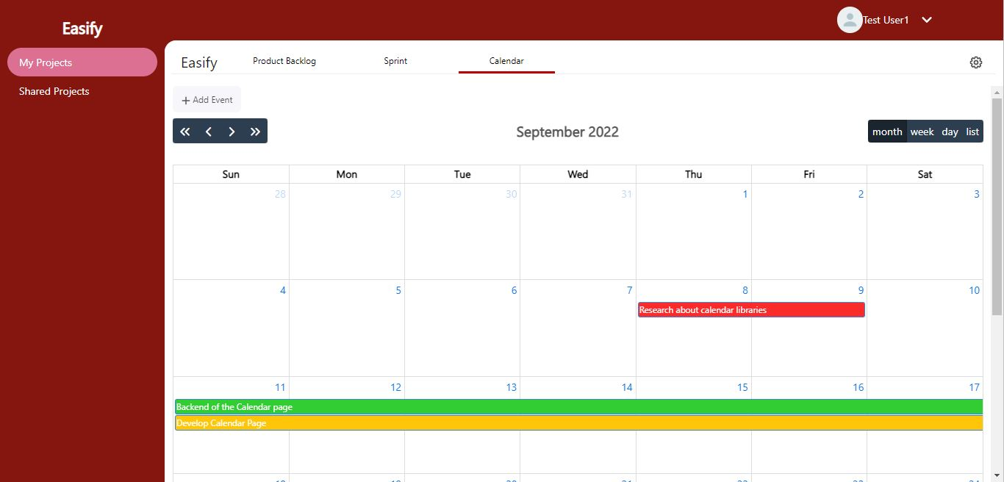
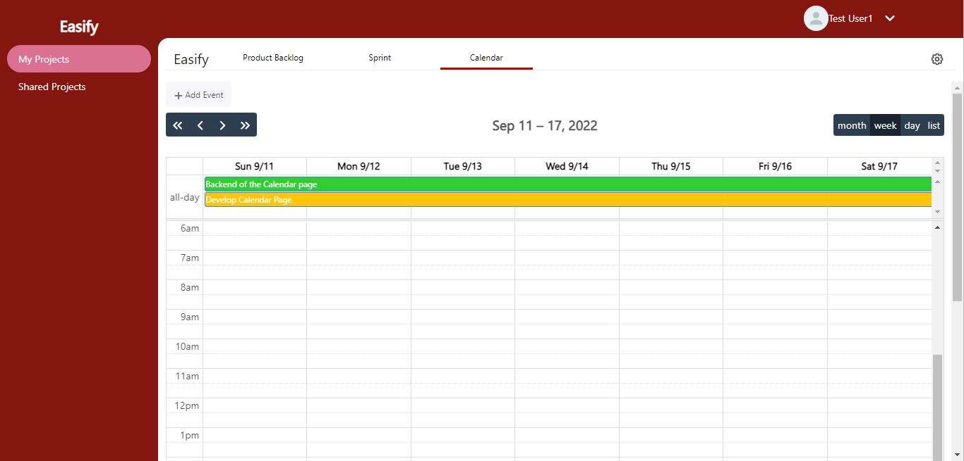
Sprint - 5: Results
Calendar Month View
Users can see all the events of selected month. It is a default calendar view.
Calendar Week View
Users can see all the events of selected week. Events are listed by day and time.

Slide 20

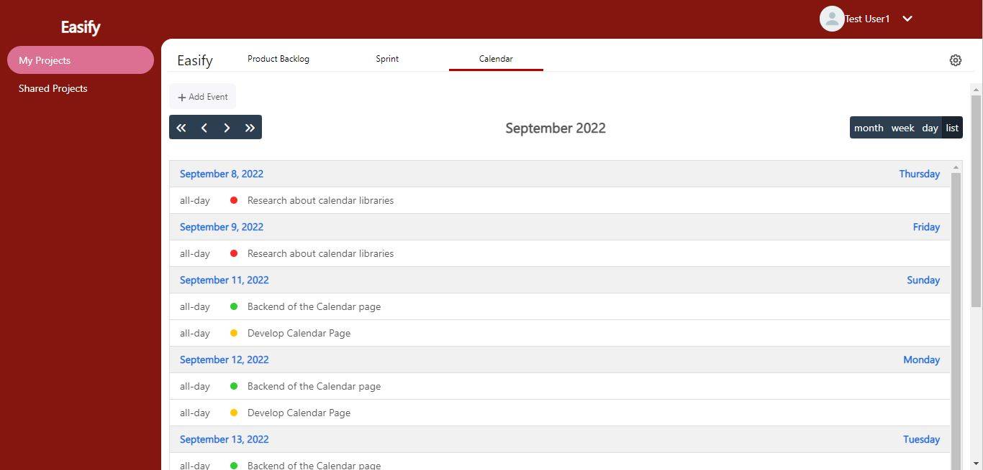
Sprint - 5: Results Continue…
Calendar Day View
Users can see all the events and their time of selected Day.
Calendar List View
Users can see list of events of selected month. It is list view.

Slide 21
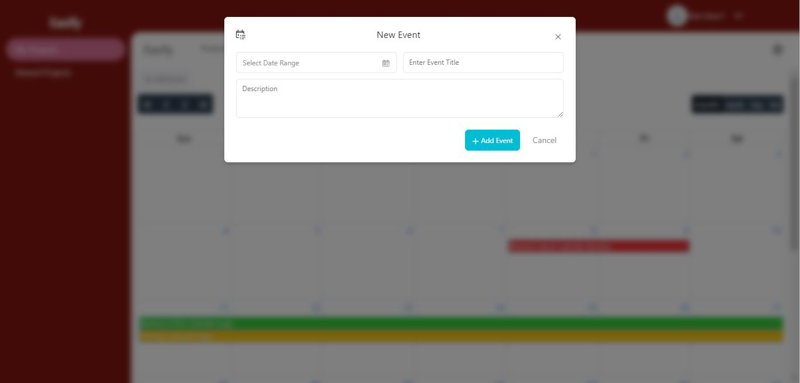
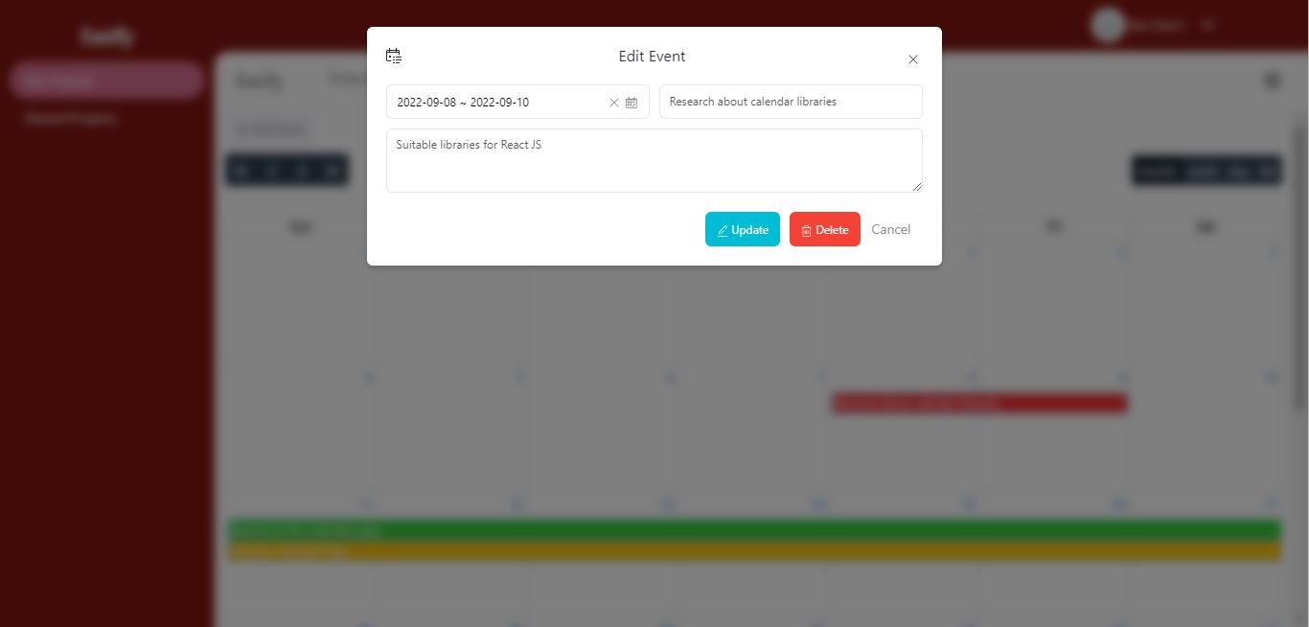
Sprint - 5: Results Continue…
Calendar Add Event
Users can add an event by selecting date range and giving title and description for the event.
Calendar Update-Delete Event
Users can edit event details and also can delete the event.

Slide 22
Sprint 5
Sprint 6
Completed feature: Calendar
We developed the front-end and back-end for Calendar feature
Easify users can now create events by providing date range, title and description to plan their work
Also modify events by dragging from one date to another.
Completed feature: Attachment, Activity Map
Attachment feature:
Easify users can upload the photos to Easify and can preview them
Other project members can see the photos and also download it
Activity Map feature:
Easify users can create activity maps for their projects and can also download them

Slide 23
Improvement from the Professor’s Feedback
1) Explain more about roles
2) Avoid bullet points. Write in the essay or give numbers.
3) In MVP, write features name and functionalities.
4) In Product Backlog, show user stories that are added or removed.
5) Don't show tasks in committed artifacts.
6) Give id to test cases.
7) For burndown charts, use days vs story points and remove bars, use only lines.
8) In the Velocity chart, show the average velocity also. Put ratio, how much % you completed in that sprint
9) Put a slide for the committed/ completed ratio.
10) Put results of the current sprint with that sprint details, not after future work. Write some information about the screenshot (results).
11) Follow the slide order given in the checklist.

Slide 24
Product Backlog
User Story: As a developer or creator, I want to be able to upload the images so that I can save my outcome or a problem
Acceptance Criteria: Given developer or creator is on attachment screen, when user click on upload image and try to upload image from personal device, then system should accept image files
User Story: As a developer or creator, I want to be able to see the images uploaded by me or other members so that I can see which photos are uploaded
Acceptance Criteria: Given developer or creator is on attachment screen, then system should display the files uploaded by all project members
User Story: As a developer or creator, I want to be able to perform some operations (like fullscreen preview, rotate, zoom in-out, flip, download) on the images so that I can perform these operations within the system itself
Acceptance Criteria:
• Given developer or creator is on attachment screen, when user click on the full screen mode, then system should display the image full screen
• Given developer or creator is on attachment screen, when user click on the rotate or flip mode, then system should rotate or flip the image accordingly
• Given developer or creator is on attachment screen, when user click on the zoom in & out mode, then system should zoom the image accordingly
• Given developer or creator is on attachment screen, when user click on the download button, then system should download the image.
User Story: As a developer or creator, I want to be able to delete the uploaded images so that I can remove unnecessary/ wrong photos
Acceptance Criteria: Given developer or creator is on attachment screen, when user click on the delete image, then system should delete the image from the database

Slide 25
Product Backlog Continue
User Story: As a product owner or scrum master or creator, I want to be able to create user activity map for the project so that I can understand the user activities better
Acceptance Criteria:
• Given product owner or scrum master or creator is on activity map screen, when user click on create node for the activity map, then system should create the node
• Given product owner or scrum master or creator is on activity map screen, when user connects the nodes for the activity map, then system should connects the node
User Story: As a product owner or scrum master or creator, I want to be able to download user activity map so that I can share it with other people
Acceptance Criteria: Given product owner or scrum master or creator is on activity map screen, when user click on download activity map, then system should download the activity map
User Story: As a product owner or scrum master or creator, I want to be able to edit/ delete user activity map so that I can modify the user activities
Acceptance Criteria:
• Given product owner or scrum master or creator is on activity map screen, when user edit the node or edge, then system should modify the node or edges details in database
• Given product owner or scrum master or creator is on activity map screen, when user delete the node or edge, then system should delete the node and connected edges from the database
User Story: As a product owner or scrum master or developer or creator, I want to be able to see the chat group for the projects so that I can chat with others about the project
Acceptance Criteria: Given product owner or scrum master or developer or creator is on Chat screen, then system should display the project groups

Slide 26
Product Backlog Continue
User Story: As a product owner or scrum master or developer or creator, I want to be able to send messages in project group so that I can notify others about tasks or bugs
Acceptance Criteria: Given product owner or scrum master or developer or creator is on Chat screen, when user type any message and click on send, then system should send the messages to project group
User Story: As a new user, I want to be able to receive authentication email so that the system can authenticate me
Acceptance Criteria:
• Given user entered right OTP, when user click on register button, then account should be created
• Given user entered wrong OTP, when user click on register button, then system has to display error message
User Story: As a product owner or scrum master or developer or creator, I want to be able to receive the messages from project group so that we can interact with each other and keep track of the work
Acceptance Criteria: Given product owner or scrum master or developer or creator is on Chat screen, when user click on any project group, then system should display all the messages which are send by the user or others
User Story: As a registered user, I want to be able to request for change the password if I forgot it so that I don't lose my account and data
Acceptance Criteria: Given user forgot the password, when user click on forgot password, then system should ask for new password, confirm password and OTP and user should receive OTP through email

Slide 27
Product Backlog Continue
User Story: As a user, I want to be able to edit my details such as name and profile photo so that I can edit my profile
Acceptance Criteria:
• Given user is on profile page, when user click on edit photo and try to upload image from personal device, then system should accept image file
• Given on profile page and name field is empty, when user click on update profile, then system should display error message
• Given on profile page user did not select any photo, when user click on update profile, then system should take default profile avatar photo
User Story: As a creator of the project, I want to be able to change the project profile photo, so that I can update project photo
Acceptance Criteria:
• Given user is creator of the project, when user change the photo, then system should accept image file and photo should be updated in database
• Given user is not creator of the project, when user try to change project settings, then system should not allow to change the project settings
User Story: As a user, I want to be able to change my password so that I can keep my account secure
Acceptance Criteria: Given user is on profile page, when user click on change password, then system should ask for new password, confirm password and OTP and user should receive OTP through email

Slide 28

Sprint 6

Slide 29
Sprint - 6: Committed and Completed Artifacts
Total 22 Story Points
100% Completed
User Story: As a developer or creator, I want to be able to upload the images so that I can save my outcome or a problem
Acceptance Criteria: Given developer or creator is on attachment screen, when user click on upload image and try to upload image from personal device, then system should accept image files
EAS-70
Points - 3
User Story: As a developer or creator, I want to be able to see the images uploaded by me or other members so that I can see which photos are uploaded
Acceptance Criteria: Given developer or creator is on attachment screen, then system should display the files uploaded by all project members
EAS-71
Points - 2
User Story: As a developer or creator, I want to be able to perform some operations (like fullscreen preview, rotate, zoom in-out, flip, download) on the images so that I can perform these operations within the system itself
Acceptance Criteria:
• Given developer or creator is on attachment screen, when user click on the full screen mode, then system should display the image full screen
• Given developer or creator is on attachment screen, when user click on the rotate or flip mode, then system should rotate or flip the image accordingly
• Given developer or creator is on attachment screen, when user click on the zoom in & out mode, then system should zoom the image accordingly
• Given developer or creator is on attachment screen, when user click on the download button, then system should download the image.
EAS-72
Points - 5
User Story: As a developer or creator, I want to be able to delete the uploaded images so that I can remove unnecessary/ wrong photos
Acceptance Criteria: Given developer or creator is on attachment screen, when user click on the delete image, then system should delete the image from the database
EAS-73
Points - 2

Slide 30
Sprint - 6: Committed and Completed Artifacts Continue
User Story: As a product owner or scrum master or creator, I want to be able to create user activity map for the project so that I can understand the user activities better
Acceptance Criteria:
• Given product owner or scrum master or creator is on activity map screen, when user click on create node for the activity map, then system should create the node
• Given product owner or scrum master or creator is on activity map screen, when user connects the nodes for the activity map, then system should connects the node
EAS-74
Points - 5
Total 22 Story Points
100% Completed
EAS-76
Points - 2
User Story: As a product owner or scrum master or creator, I want to be able to download user activity map so that I can share it with other people
Acceptance Criteria: Given product owner or scrum master or creator is on activity map screen, when user click on download activity map, then system should download the activity map
User Story: As a product owner or scrum master or creator, I want to be able to edit/ delete user activity map so that I can modify the user activities
Acceptance Criteria:
• Given product owner or scrum master or creator is on activity map screen, when user edit the node or edge, then system should modify the node or edges details in database
• Given product owner or scrum master or creator is on activity map screen, when user delete the node or edge, then system should delete the node and connected edges from the database
EAS-75
Points - 3

Slide 31
Sprint - 6: Sprint Backlog
ID | Item | Priority | Story Points | Status
EAS-70 | As a developer or creator, I want to be able to upload the images so that I can save my outcome or a problem | Mid | 3 | Done
EAS-71 | As a developer or creator, I want to be able to see the images uploaded by me or other members so that I can see which photos are uploaded | Mid | 2 | Done
EAS-72 | As a developer or creator, I want to be able to perform some operations (like fullscreen preview, rotate, zoom in-out, flip, download) on the images so that I can perform these operations within the system itself | Mid | 5 | Done
EAS-73 | As a developer or creator, I want to be able to delete the uploaded images so that I can remove unnecessary/ wrong photos | Mid | 2 | Done
EAS-74 | As a product owner or scrum master or creator, I want to be able to create user activity map for the project so that I can understand the user activities better | Mid | 5 | Done
EAS-75 | As a product owner or scrum master or creator, I want to be able to edit/ delete user activity map so that I can modify the user activities | Mid | 3 | Done
EAS-76 | As a product owner or scrum master or creator, I want to be able to download user activity map so that I can share it with other people | Mid | 2 | Done
EAS-77 | Develop Attachment Screen | High | NA | Done

Slide 32
Sprint - 6: Sprint Backlog Continue
ID | Item | Priority | Story Points | Status
EAS-78 | Design backend APIs and controllers to perform CRUD operations on Attachment data | High | NA | Done
EAS-79 | Setup the AWS S3 bucket with Laravel Backend | Mid | NA | Done
EAS-80 | Develop Activity Map Screen | High | NA | Done
EAS-80 | Design backend APIs and controllers to perform CRUD operations on Activity Map data | High | NA | Done
EAS-81 | Integrate Attachment and Activity Map with Project screens and Backend APIs | High | NA | Done
EAS-82 | Testing for Sprint - 6 | Mid | NA | Done
EAS-83 | Create presentation for Deliverable - 6 | Low | NA | Done
EAS-84 | Create presentation video and demo video for Deliverable - 6 | Mid | NA | Done
EAS-85 | Update Tech Paper | Low | NA | Done
EAS-86 | Update Github Wiki page | Low | NA | Done

Slide 33
Sprint - 6: Test Cases
ID | User Story ID | Feature | Test Case | Expected Output | Actual Outcome | Status
EAST-30 | EAS-70 | Attachment | User wants to upload image | User should be able to upload the image | User is able to upload the images | Pass
EAST-31 | EAS-71 | Attachment | User wants to see all the uploaded images | User should be able to see all the uploaded the images | User is able to see the uploaded the images | Pass
EAST-32 | EAS-72 | Attachment | User wants to see the image in fullscreen mode | User should be able to see the image in fullscreen mode | User is able to see the image in fullscreen mode | Pass
EAST-33 | EAS-72 | Attachment | User wants to rotate or flip the image | User should be able to rotate and flip the image | User is able to rotate and flip the image | Pass
EAST-34 | EAS-72 | Attachment | User wants to zoom in & out the image | User should be able to zoom in & out the image | User is able to zoom in & out the image | Pass
EAST-35 | EAS-72 | Attachment | User wants to download the image | User should be able to download the image | User is able to download the image | Pass
EAST-36 | EAS-73 | Attachment | User wants to delete the uploaded image | User should be able to delete the uploaded the image | User is able to delete the uploaded the image | Pass

Slide 34
Sprint - 6: Test Cases Continue
ID | User Story ID | Feature | Test Case | Expected Output | Actual Outcome | Status
EAST-37 | EAS-74 | Activity Map | User wants to create node for activity map | User should be able to create node for activity map | User is able to create node for activity map | Pass
EAST-38 | EAS-74 | Activity Map | User wants to connect the nodes for activity map | User should be able to connect the nodes for activity map | User is able to connect the nodes for activity map | Pass
EAST-39 | EAS-75 | Activity Map | User wants to edit the node or edge | User should be able to edit the node or edge | User is able to edit the node or edge | Pass
EAST-40 | EAS-75 | Activity Map | User wants to delete the node or edge | User should be able to delete the node or edge | User is able to delete the node or edge | Pass
EAST-41 | EAS-76 | Activity Map | User wants to download the activity map | User should be able to download the activity map | User is able to download the activity map | Pass

Slide 35
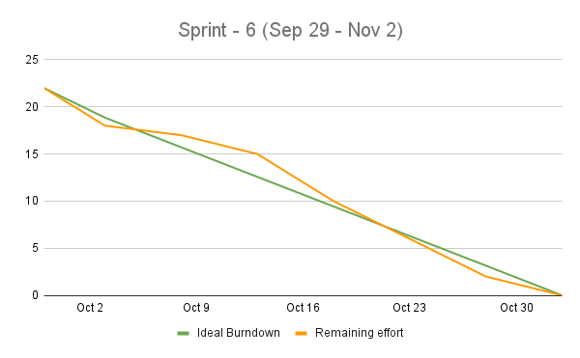
Sprint - 6: Burndown Chart

Slide 36
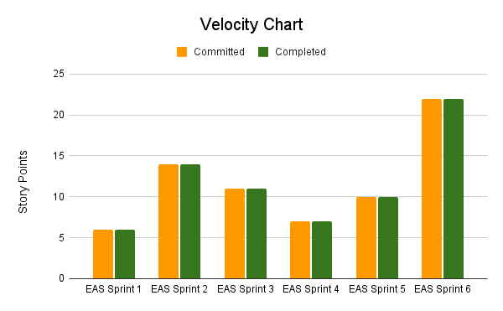
Velocity
Average Velocity
= (6+14+11+7+10+22)/6
= 11.67

Slide 37
Completed Committed Ratio
Sprint | Committed | Completed | Ratio
EAS Sprint 1 | 6 | 6 | 100.00%
EAS Sprint 2 | 14 | 14 | 100.00%
EAS Sprint 3 | 11 | 11 | 100.00%
EAS Sprint 4 | 7 | 7 | 100.00%
EAS Sprint 5 | 10 | 10 | 100.00%
EAS Sprint 6 | 22 | 22 | 100.00%
Average Completed Committed Ratio = 100%
Current Completed Committed Ratio (Sprint 6) = 100%

Slide 38
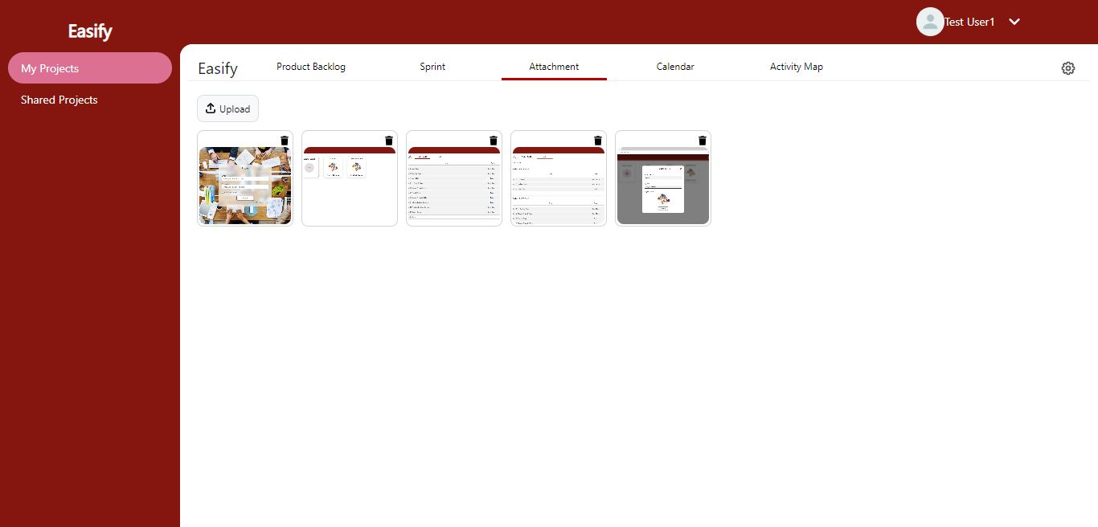
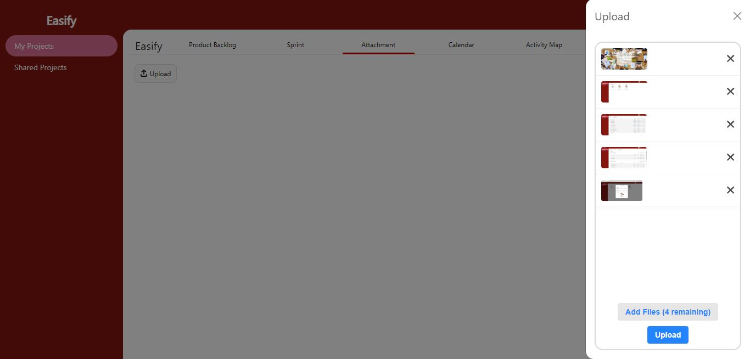
Sprint - 6: Results
Attachment Page
Users can see the uploaded photos by projects members. Also can delete the photo.
Attachment Page - Upload Dropzone
Users can drop or browse the photos in the right side dropzone. Max file limit is 9 files. Users can also cancel the uploading of each photo.

Slide 39
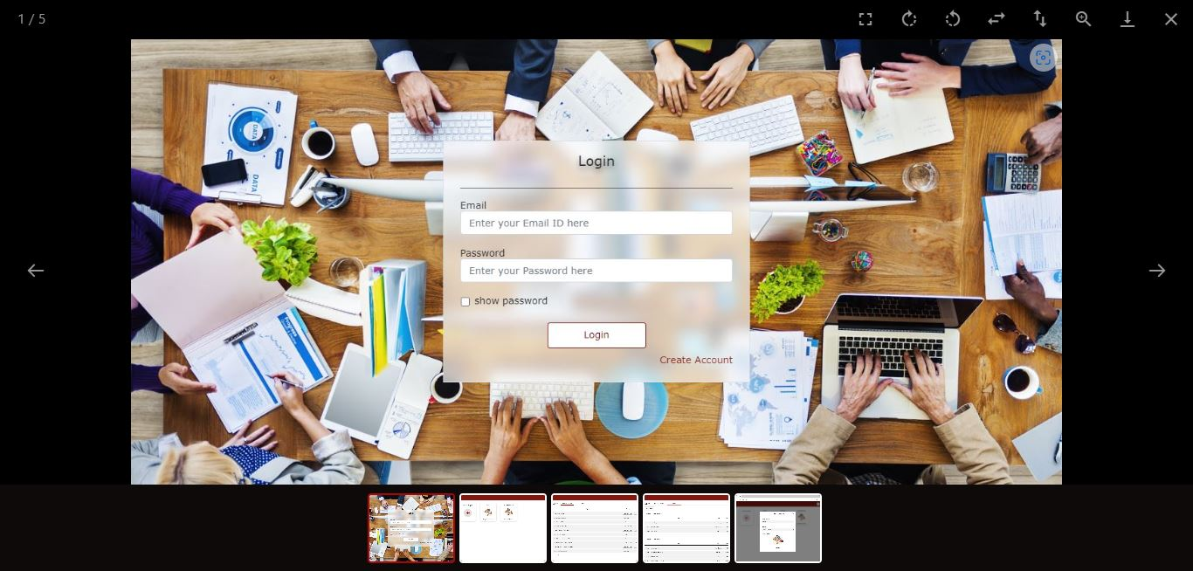
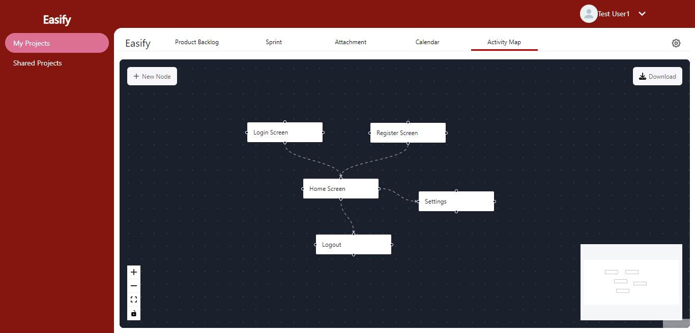
Sprint - 6: Results Continue
Attachment Page - Photo Preview
Users can preview the photos and also can rotate, flip horizontally-vertically, zoom in & out and download the photo.
Activity Map Page
Users can create activity maps for their projects. They can also zoom in & out and download the activity map.

Slide 40
Sprint - 6: Backend APIs
We have developed following APIs in order to complete Attachment and Activity Map feature:
To upload attachment: ‘/api/attachment/create’ POST
To fetch attachment: ‘/api/attachment/fetch’ POST
To delete attachment: ‘/api/attachment/delete’ POST
To fetch activity map: ‘/api/activity-map/fetch’ POST
To update activity map: ‘/api/activity-map/update’ POST

Slide 41
Retrospective
What went well
Completed our work at schedule time
What can be improved
Have to work faster on the research to catch up the schedule
Team interactions can be improved
Action items
Speed up the research to keep up schedule

Slide 42
Sprint - 7 User Stories
User Story: As a product owner or scrum master or developer or creator, I want to be able to see the chat group for the projects so that I can chat with others about the project
Acceptance Criteria: Given product owner or scrum master or developer or creator is on Chat screen, then system should display the project groups
User Story: As a product owner or scrum master or developer or creator, I want to be able to send messages in project group so that I can notify others about tasks or bugs
Acceptance Criteria: Given product owner or scrum master or developer or creator is on Chat screen, when user type any message and click on send, then system should send the messages to project group
User Story: As a product owner or scrum master or developer or creator, I want to be able to receive the messages from project group so that we can interact with each other and keep track of the work
Acceptance Criteria: Given product owner or scrum master or developer or creator is on Chat screen, when user click on any project group, then system should display all the messages which are send by the user or others

Slide 43

Group Wiki
https://github.com/DV192/Stonecrusher/wiki

Slide 44
Thank You

